Slide 1
Convolutional Neural Networks

Slide 2
Last time: Fully connected layer

Slide 3
Last time: Neural Networks

Slide 4
Next: Convolutional Neural Networks

Slide 5
Convolutional Layer

Slide 6
Convolutional layer

Slide 7
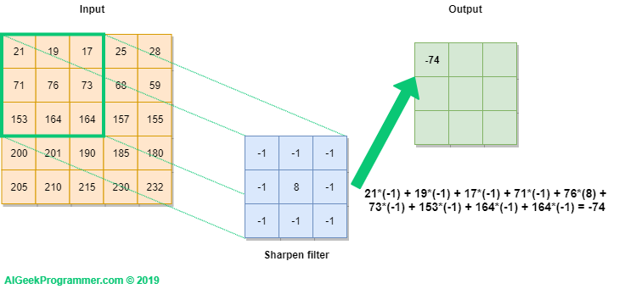
Convolutional layer

Slide 8
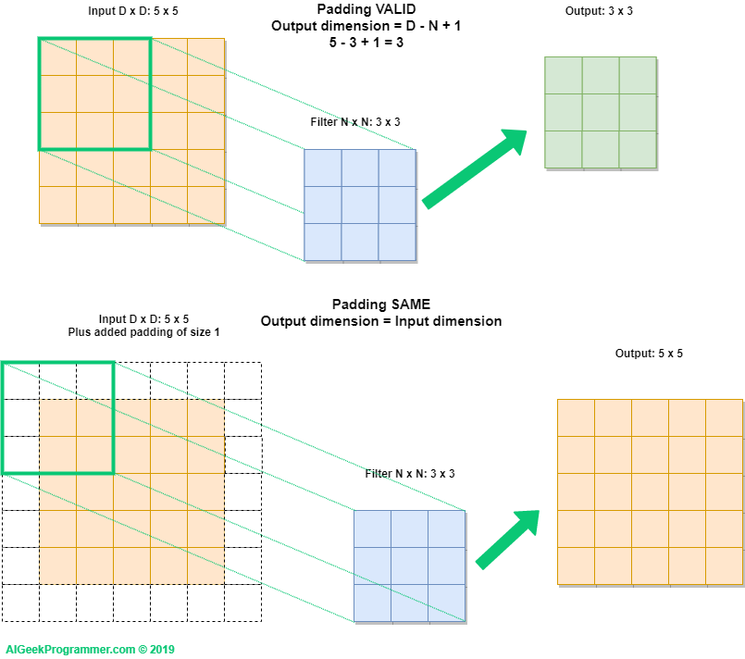
Convolutional layer

Slide 9
Convolutional layer

Slide 10
Convolutional Layer

Slide 11
Convolutional Layer
Filters move spatial-wise, not depth-wise

Slide 12
Convolutional Layer

Slide 13
Convolutional Layer
An activation map is a sheet of neuron outputs
1) Each is connected to a small region (receptive field, 感受野) in the input
2) All of them share parameters → translation invariant

Slide 14
Convolutional Layer
Consider another green filter

Slide 15
Convolutional Layer

Slide 16
ConvNet

Slide 17
ConvNet

Slide 18
Visualization
Let’s see what the Inputs maximizing the activations of conv neurons look like
points, edges, …
corners, blobs, …

Slide 19
A closer look at spatial dimensions

Slide 20
In practice: common to zero pad the border

Slide 21
In practice: common to zero pad the border

Slide 22
In practice: common to zero pad the border

Slide 23
In practice: common to zero pad the border
Now it is possible to build a very deep ConvNet

Slide 24
Example

Slide 25
Example

Slide 26
Example

Slide 27
Example

Slide 28
Example
Number of add&mul operations in this layer?

Slide 29
Example
Number of add&mul operations in this layer?
each output neuron has 5x5x3 ops, and there are 32x32x10 output neurons => 32x32x10x5x5x3

Slide 30
Summary

Slide 31
1x1 convolution
Q: Is a fully-connected layer a convolutional layer?

Slide 32
Pooling Layer

Slide 33
Pooling layer
To make the representations smaller and more manageable
Operates over each activation map independently: output-depth = input-depth
Notes:
会降低卷积特征的采样率（以节省处理时间），从而减少特征图的维数，同时仍保留最关键的特征信息。

Slide 34
Max Pooling
Notes:
会降低卷积特征的采样率（以节省处理时间），从而减少特征图的维数，同时仍保留最关键的特征信息。

Slide 35
Summary

Slide 36
Summary

Slide 37
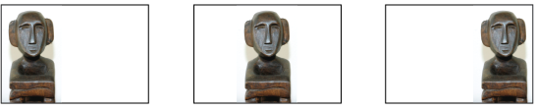
Convolution + Pooling ≈ Translation invariance
Convolution: local feature detector
Pooling: invariant to small translation

Slide 38
Taking-home messages
ConvNets stack CONV, POOL, FC layers
Trend towards smaller filters and deeper architectures
Trend towards getting rid of POOL/FC layers (just CONV)
Typical architectures look like:
[(CONV-RELU)*N-POOL?]*M-(FC-RELU)*K-SOFTMAX
where N is usually up to ~5, M is large, 0 <= K <= 2. But recent advances such as ResNet challenge this paradigm
Convolution + Pooling ≈ Translation invariance

Slide 39
CNN Architectures

Slide 40
LeNet-5 [LeCun et al., 1998]

Slide 41

ImageNet
1,000 class 1.28M training 50K validation 100K testing
https://www.image-net.org/index.php

Slide 42
AlexNet [Krizhevsky et al. 2012]

Slide 43
AlexNet [Krizhevsky et al. 2012]

Slide 44
AlexNet [Krizhevsky et al. 2012]

Slide 45
AlexNet [Krizhevsky et al. 2012]

Slide 46
AlexNet [Krizhevsky et al. 2012]

Slide 47
AlexNet [Krizhevsky et al. 2012]

Slide 48
AlexNet [Krizhevsky et al. 2012]

Slide 49
AlexNet [Krizhevsky et al. 2012]

Slide 50
AlexNet [Krizhevsky et al. 2012]

Slide 51
AlexNet [Krizhevsky et al. 2012]

Slide 52
AlexNet [Krizhevsky et al. 2012]

Slide 53
AlexNet [Krizhevsky et al. 2012]

Slide 54
AlexNet [Krizhevsky et al. 2012]

Slide 55
AlexNet [Krizhevsky et al. 2012]

Slide 56
ZFNet [Zeiler and Fergus, 2013]

Slide 57
ZFNet [Zeiler and Fergus, 2013]

Slide 58
VGGNet [Simonyan and Zisserman, 2014]

Slide 59
VGGNet [Simonyan and Zisserman, 2014]

Slide 60
VGGNet [Simonyan and Zisserman, 2014]

Slide 61
VGGNet [Simonyan and Zisserman, 2014]

Slide 62
VGGNet [Simonyan and Zisserman, 2014]
Notes:
一个filter 7x7xC, C个filter 7x7xCxC

Slide 63
VGGNet [Simonyan and Zisserman, 2014]

Slide 64
VGGNet [Simonyan and Zisserman, 2014]

Slide 65
VGGNet [Simonyan and Zisserman, 2014]

Slide 66
VGGNet [Simonyan and Zisserman, 2014]

Slide 67
GoogLeNet [Szegedy et al., 2014]

Slide 68
GoogLeNet [Szegedy et al., 2014]

Slide 69
GoogLeNet [Szegedy et al., 2014]

Slide 70
GoogLeNet [Szegedy et al., 2014]

Slide 71
GoogLeNet [Szegedy et al., 2014]

Slide 72
GoogLeNet [Szegedy et al., 2014]

Slide 73
GoogLeNet [Szegedy et al., 2014]

Slide 74
GoogLeNet [Szegedy et al., 2014]

Slide 75
GoogLeNet [Szegedy et al., 2014]

Slide 76
GoogLeNet [Szegedy et al., 2014]

Slide 77
GoogLeNet [Szegedy et al., 2014]

Slide 78
GoogLeNet [Szegedy et al., 2014]

Slide 79
GoogLeNet [Szegedy et al., 2014]

Slide 80
GoogLeNet [Szegedy et al., 2014]

Slide 81
GoogLeNet [Szegedy et al., 2014]

Slide 82
GoogLeNet [Szegedy et al., 2014]

Slide 83
GoogLeNet [Szegedy et al., 2014]

Slide 84
GoogLeNet [Szegedy et al., 2014]

Slide 85
GoogLeNet [Szegedy et al., 2014]

Slide 86
GoogLeNet [Szegedy et al., 2014]

Slide 87
GoogLeNet [Szegedy et al., 2014]

Slide 88
GoogLeNet [Szegedy et al., 2014]

Slide 89
GoogLeNet [Szegedy et al., 2014]

Slide 90
GoogLeNet [Szegedy et al., 2014]

Slide 91
GoogLeNet [Szegedy et al., 2014]

Slide 92
GoogLeNet [Szegedy et al., 2014]

Slide 93
ResNet [He et al., 2015]

Slide 94
ResNet [He et al., 2015]

Slide 95
ResNet [He et al., 2015]

Slide 96
ResNet [He et al., 2015]

Slide 97
ResNet [He et al., 2015]

Slide 98
ResNet [He et al., 2015]

Slide 99
ResNet [He et al., 2015]
Notes:
Why it is harder to train a deeper model?
Gradient vanishing or exploding？ No. This problem, however, has been largely addressed by normalized initialization and intermediate normalization layers (BN).
The stacking of several non-linear
transformations in conventional feed-forward network architectures typically results in poor propagation
of activations and gradients. Hence it remains hard to investigate the benefits of very deep
networks for a variety of problems.

Slide 100
ResNet [He et al., 2015]

Slide 101
ResNet [He et al., 2015]
He et al. hypothesize that it is easier to optimize the residual mapping than to optimize the original, unreferenced mapping

Slide 102
ResNet [He et al., 2015]

Slide 103
ResNet [He et al., 2015]

Slide 104
ResNet [He et al., 2015]

Slide 105
ResNet [He et al., 2015]

Slide 106
ResNet [He et al., 2015]

Slide 107
ResNet [He et al., 2015]

Slide 108
ResNet [He et al., 2015]

Slide 109
ResNet [He et al., 2015]

Slide 110
ResNet [He et al., 2015]

Slide 111
ResNet [He et al., 2015]

Slide 112
Comparison

Slide 113
Comparison

Slide 114
Comparison

Slide 115
Comparison

Slide 116
Comparison

Slide 117
Comparison

Slide 118
Comparison

